Slide 1
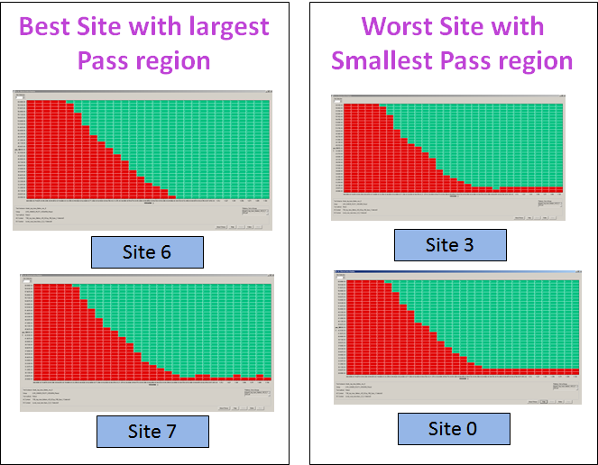
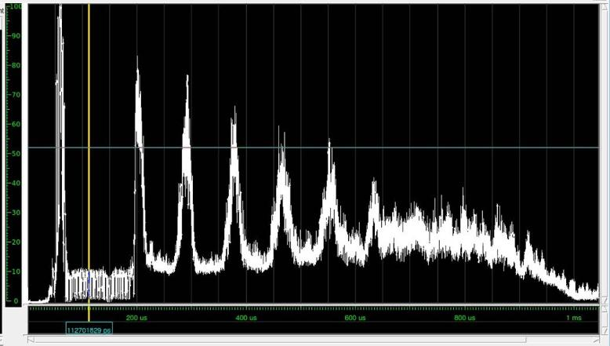
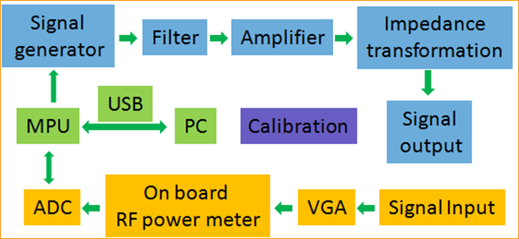
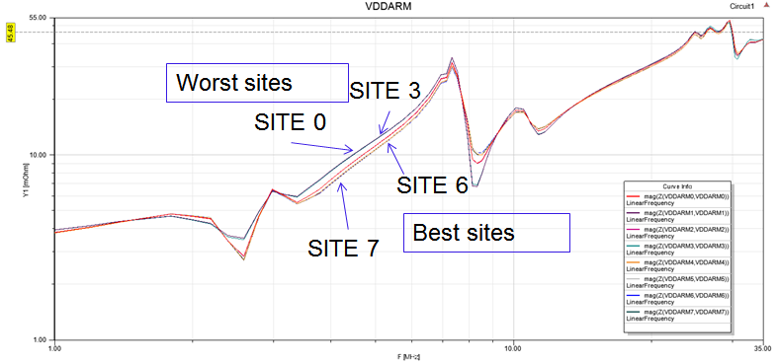
ITC 2016 PO 16: Testing Yield Improvement by Optimizing the Impedance of Power Delivery Network on DIB
Jintao Shi Zaiman Chen and Yu Huang Peilai Zhang
Scan Test Challenges Caused by IR Drop
Shmoo of the Same Device on 8 Different Sites
Transition delay at-speed tests are sensitive to IR drops on the power supplies
Impedances of Power Delivery Network (PDN) on Device Interface Board (DIB) have big impact on the IR drop
In multi-site testing, different sites may have different PDN impedances vs. frequencies due to variations of layout traces or capacitance values
Multi-site testing may introduce even larger yield loss due to variations of IR drops on PDNs
Proposed Flow
Step 1: Analyze
Step 1. Analyze test power to identify sensitive frequencies and calculate the impedance thresholds at these points
Identify the sensitive frequency points, at which the worst IR drops may happen. The following is an example of peak power analysis results based on simulation.
Step 2. Measure how PDN impedances vary with frequencies at different test sites
Step 3. Optimize the PDN impedance if it is over the threshold
Step 2: Measure
A circuit is developed to scan the PDN impedance on each site. Its block diagram is illustrated as follows
With the designed circuitry, we measure the impedance vs. the frequency. In this example, the best sites are Sites 6 and 7 and the worst sites are Sites 0 and 3, which matched the shmoo results
Step 3: Optimize
If at some sensitive frequencies, the measured impedance is larger than the calculated threshold, we will tune the capacitances on the PDN such that its impedance will drop to a safe level and IR drop will not likely occur. This can minimize yield loss due to IR drops.
Notes:
Figure 4: X-axis: Time, Y-axis: Power (Current / Toggle Rate). Use it to calculate the threshold impedance – 20uO – 30uO (Micro Ohm)
Figure 3: X-axis: Frequency, Y-axis: Impedance
Figure Shmoo: X-axis: Voltage, Y-axis: Frequency
Signal output input to the force point, signal input is measure at the sense point

